Slide 1
Dependency Injection by Constructor - Injecting int and string values
We can inject the dependency by constructor.
The <constructor-arg> sub-element of <bean> is used for constructor injection.
We can inject
primitive and String-based values
Dependent object (contained object)
Collection values etc.

Slide 2
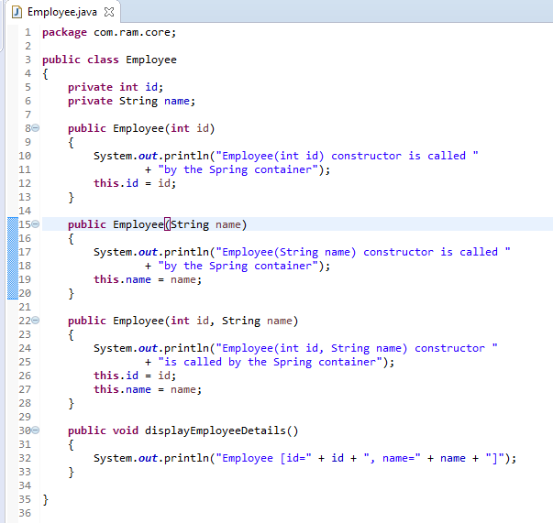
Dependency Injection by Constructor - Injecting int and string values

Slide 3
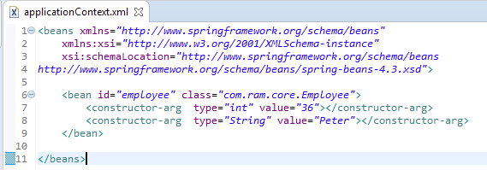
Dependency Injection by Constructor - Injecting int and string values
We are providing the information into the bean by applicationContext.xml file.
The constructor-arg element invokes the constructor.The type attributes specifies that int,String parameter constructor will be invoked. In this example Employee(int id, String name) constructor will be invoked.

Slide 4

Dependency Injection by Constructor - Injecting int and string values
Employee
What object to instantiate?
What object to configure and how to configure?
The Spring Container
(ApplicationContext)
applicationContext.xml
Employee
Object
Id=36
name=“Peter”
Create the employee object.
Configure the employee object.
Manage employee object complete life cycle from creation till destruction.

Slide 5
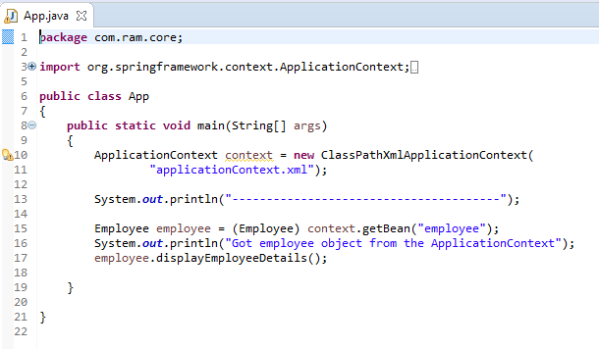
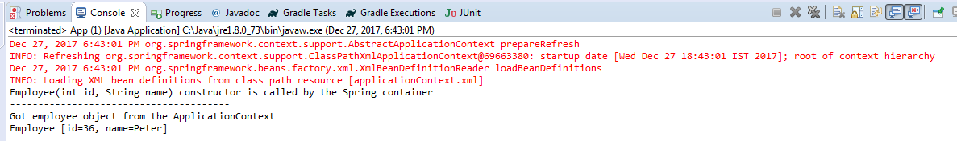
Dependency Injection by Constructor - Injecting int and string values

